Slide 1

Farmer’s Friend
Group : B2-17
Group Members : EDM17B041-RAJAT, EVD17I009-RANJAN

Slide 2
Problem Statement : Farmer Assisting System - Helping the farmers increase their crop quality and yield by minimising the use of pesticides in their farms. (SIH)
Our Product: Farmer’s Friend
Introduction : Our product “Farmer’s Friend” is an autonomous ground vehicle (rover) designed to increase the quality and yield of crop (we are focusing mainly on Tomatoes) . It is amalgamation of software and hardware which will be used by the customers mainly farmers to detect pest attacks in their farms that will work on it’s own without any human intervention. We are using image processing techniques to differentiate between healthy and defected crops.
Benefits :-
Better crop quality : minimal use of pesticides that reduces the toxicity of crops - Healthy food, Healthy life .
Reduction in soil degradation caused by excessive use of pesticides.
Reduces labour cost.
Early pest detection - Pest attacks can be detected at very initial stages.

Slide 3
How we got this idea?
We know that the world is moving towards “ORGANIC FARMING” and everybody wants to eat healthy food without chemicals and pesticides, but it is very difficult to produce crops without pesticides for such a large population. All we can do is to minimize the usage of pesticides and detect early pest attacks so that we can get rid of the pests at early stages. Hence, without loss of crops and also with least amount of pesticide we can produce good quality crops for such large population.
Hence, we came up with a Farmer assisting system that finds the infection percentage in crops using image processing and hence assists farmer the exact location where he/she must spray pesticides to control the damage.

Slide 4
What is Organic farming?
Organic farming does not mean going ‘back’ to traditional methods. Many of the farming methods used in the past are still useful today. Organic farming takes the best of these and combines them with modern scientific knowledge. In this way the farmer creates a healthy balance between nature and farming, where crops and animals can grow and thrive.
Why?
Reduces the toxic load: keeps chemicals out of the air, water, soil and our bodies.
Builds healthy soil.
Tastes better and truer flavor.
Promotes biodiversity.
Celebrates the culture of agriculture.
This is where the essence of our product lies.

Slide 5
MVP: Minimum Viable Product
Farmer’s Friend : An Autonomous Ground Vehicle :
Rover - To travel throughout the farm(tomato farm).
Crop Monitoring and image capturing.
Image processing for pest detection.
Affected Area notification.
For PDP , we have chosen the tomato crop as it is easy for rover to move in lanes of tomato crop and it is easy to diagnose and to work upon. Also, Tomato is second most grown vegetable across the world and it’s height and size makes our product more efficient to work upon.

Slide 6
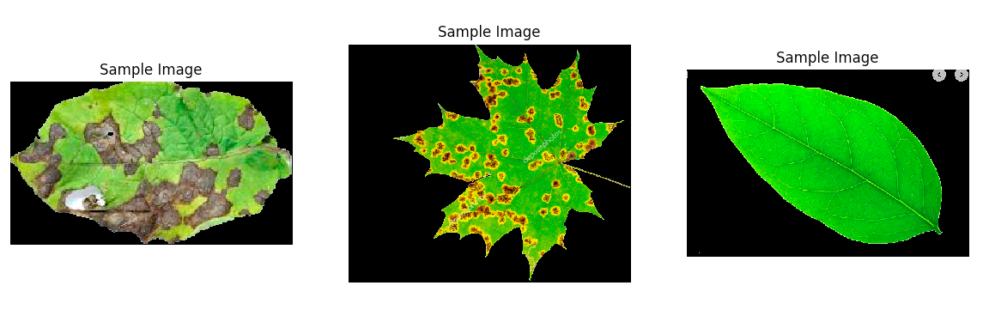
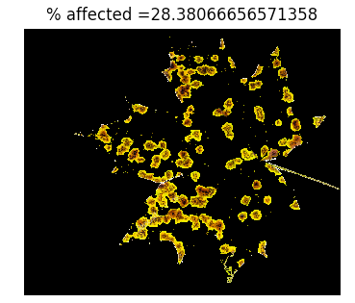
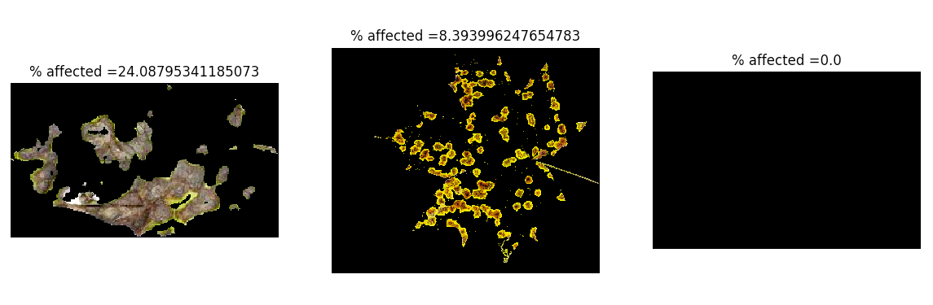
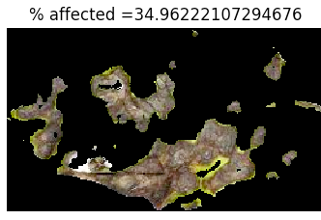
Technologies in FARMER’S FRIEND:
1. IMAGE PROCESSING: It has got a camera module that has been controlled using raspberry pi which takes the input as picture and works upon it on the basis of colour, hue, rgb pattern and thus finds out the infection in crop.
OUTPUT FROM RASPBERRY PI: The first three pictures shows the input that has been taken via pi camera module and thus the code in raspberry pi estimates the infection or crop damage according to our algorithm design that has been shown in next three picture with exact infection percentage.

Slide 7
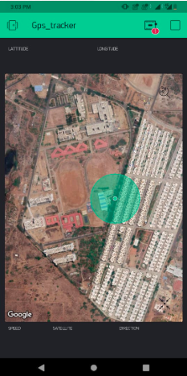
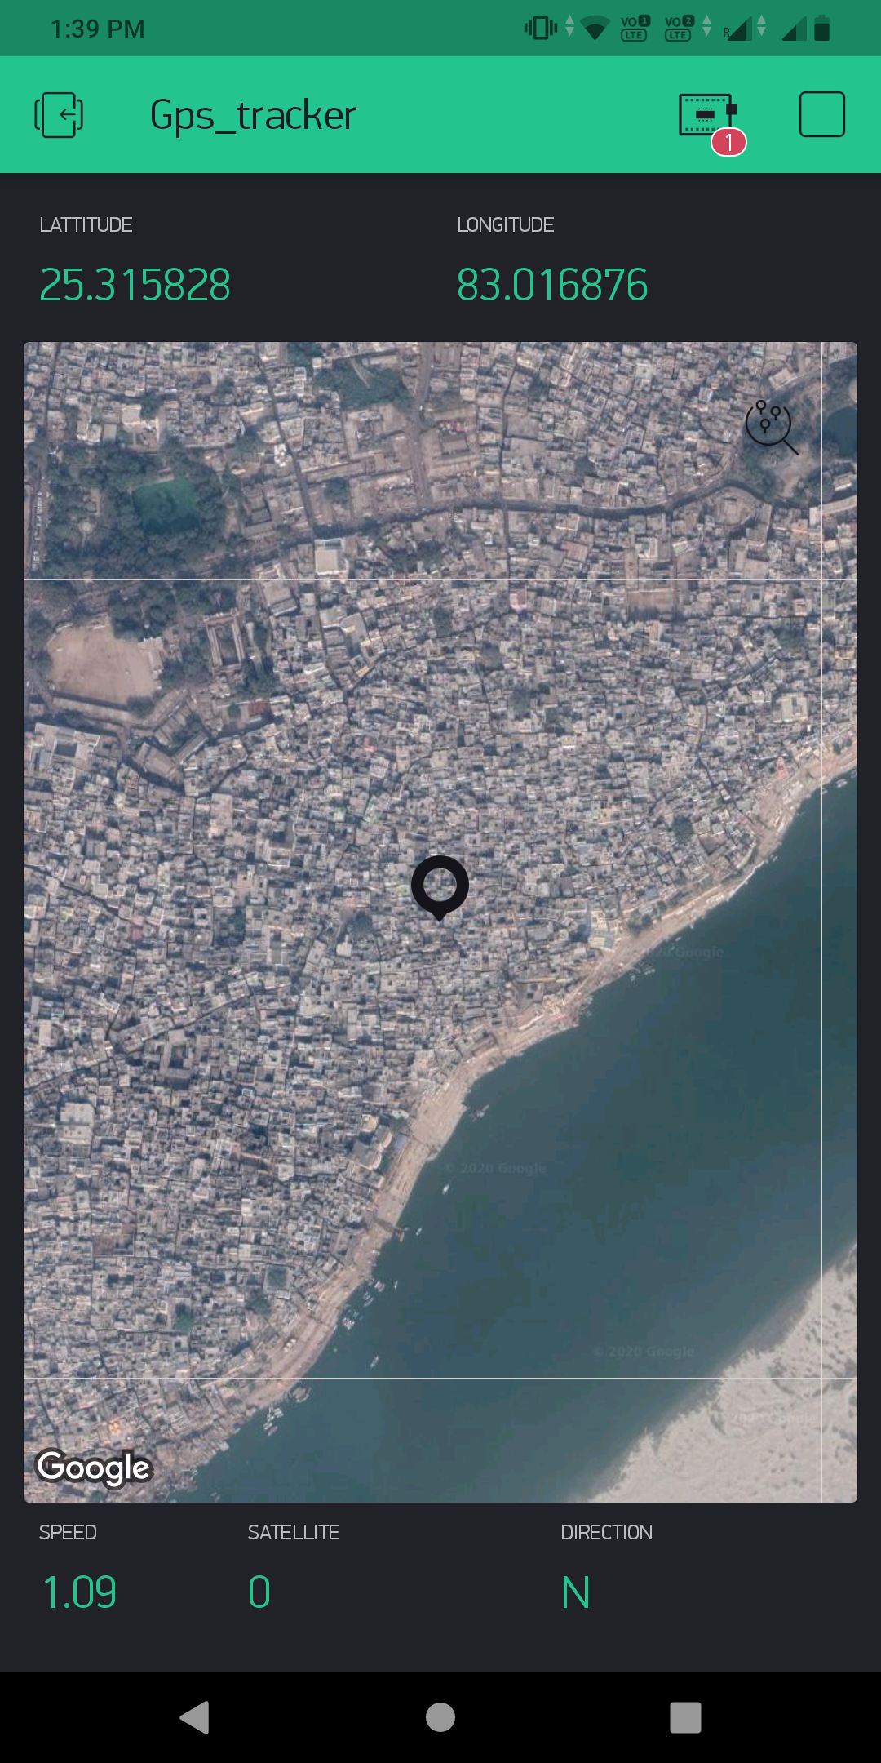
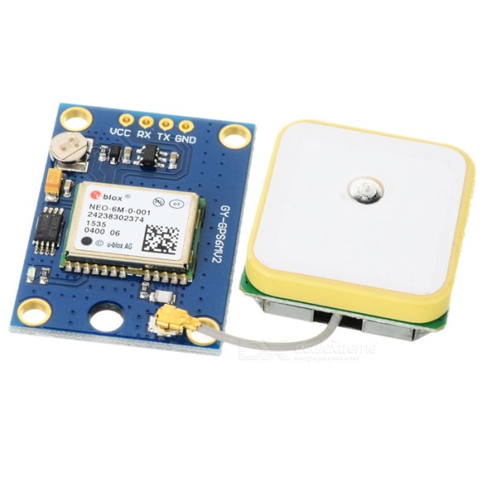
2. GPS Tracker:
LOOK OF CUSTOMISED APP: (part1)
This image shows the exact location i.e. near Arjuna complex at IIITDM where we first tested the output and we can see the exact location of our device very precisely on our customised app.
LOOK OF CUSTOMISED APP:(part 2)
You can see, the image shows the location of device which can be properly zoomed in and also exactly shows details like latitude, longitude, speed, satelite ,and direction precisely.
The NEO-6M GPS module is a well-performing complete GPS receiver with a built-in 25 x 25 x 4mm ceramic antenna, which provides a strong satellite search capability. With the power and signal indicators, you can monitor the status of the module. It got data backup battery, the module can save the data when the main power is shut down accidentally. Its 3mm mounting holes can ensure easy assembly.
DEVICE OUTLOOK:
WHY AND HOW DID WE IMPLEMENT IT?
A customized application has been made through which the farmer can track the exact location of Rover from anywhere around the globe by using a customised app that tracks the location on a map which can be zoomed like Google Maps , Our initial idea wasn’t planned like this but later we planned to make it with a customised blynk app so that farmer need not to move along with rover around the field and also if lost can be traced easily.Also it points the most affected areas of the farm (having pest attack severity above a certain threshold value) on the map of field and create database for it and then this data again can be sent to farmer’s mobile so that he can go and can spray the pesticides only on the parts where pest attack has been detected in order to reduce the excess usage of pesticides and to get a better quality crops.

Slide 8
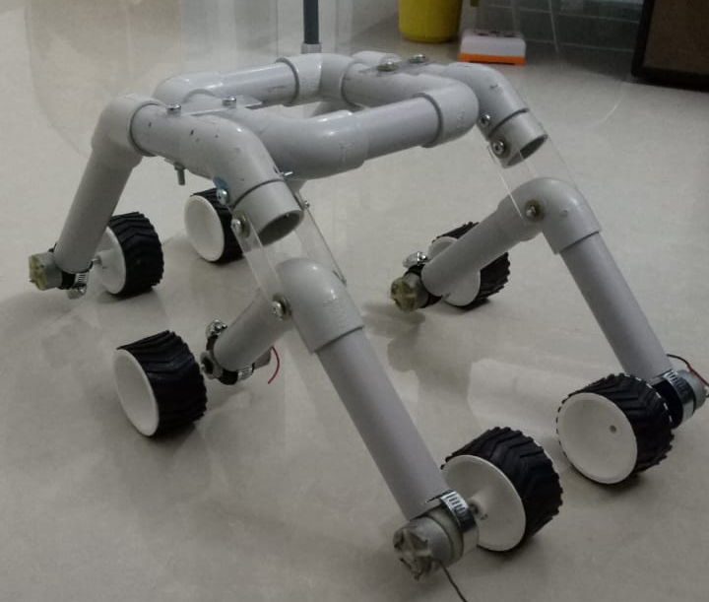
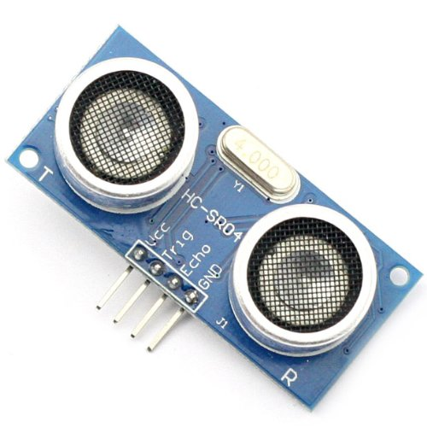
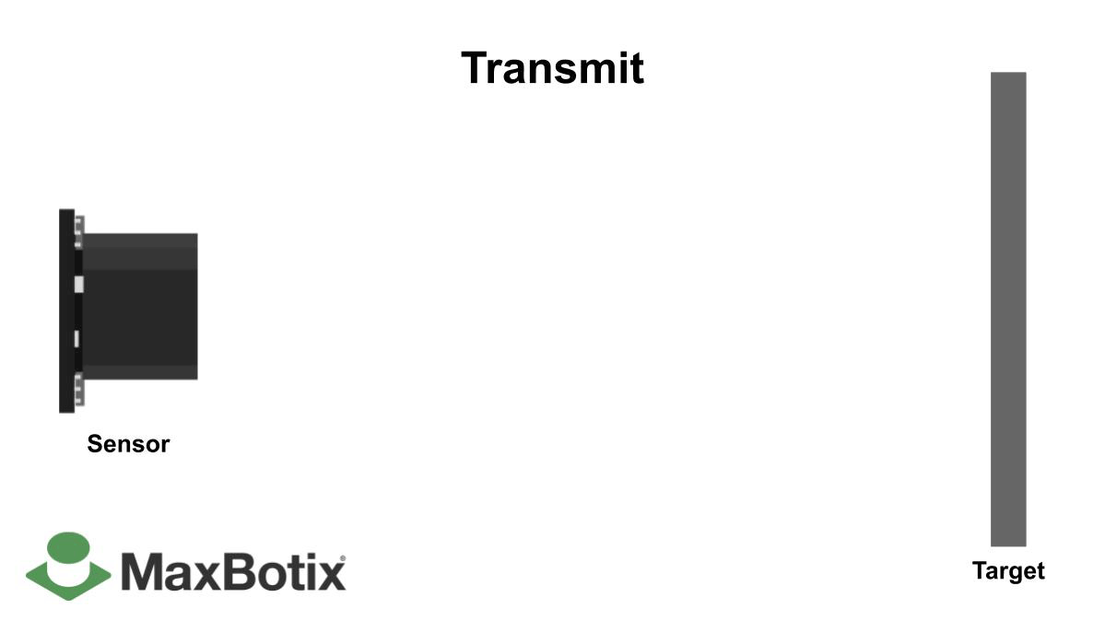
3. AUTOMATION:
You can see it has got 6 tyres and all tyres are attached with a specific dc motor and all dc motors are controlled by Arduino so that it should move according to user’s need . However along three sides we have attached sonar sensor which takes continuous input of nearby objects and if something very big comes into picture , it stops and moves left or right depending upon situation.
PIC SHOWING REAL TIME ULTRASONIC SENSOR. Functionality:
An ultrasonic sensor is an instrument that measures the distance to an object using ultrasonic sound waves.
An ultrasonic sensor uses a transducer to send and receive ultrasonic pulses that relay back information about an object’s proximity.
WORKING METHODOLOGY:
Arduino controls the movement of the rover, it has sonar sensors across three sides of the product- left, right and front that tracks the nearby objects and makes sure that the rover doesn’t collide with any obstacle. It can work on uneven surfaces and pass through the obstacles as it has been designed in such a fashion that it can cross or leap over it. The rover will move in a lane of Tomato field for 10 secs and then stops and captures the image of crop( say at left side) and then process it and then move for 10 secs again and follow it till the lane gets over and again move back to same lane to get the images of other ( say right ) side of the lane
This is just a frame of the rover without the subparts attached to it, we couldn’t assemble all the parts together because of the corona outbreak.

Slide 9
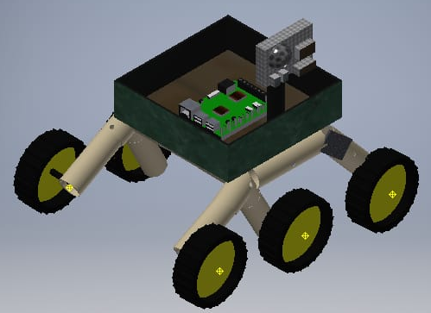
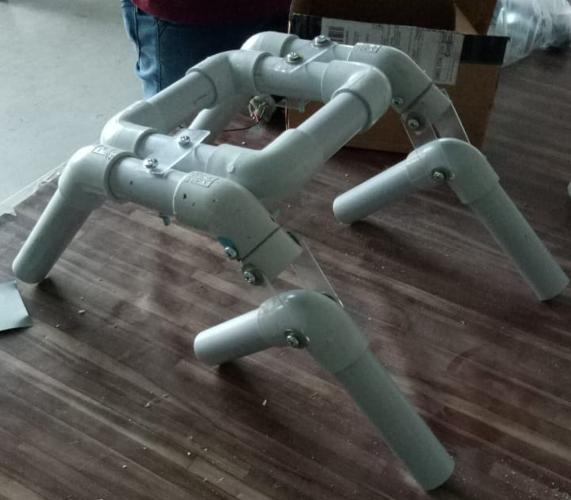
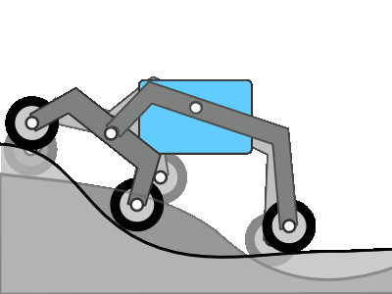
4. ROVER BODY DESIGN:
THIS BODY DESIGN IS KNOWN AS BOGIE DESIGN.
ADVANTAGES: Rocker bogie is a mechanism primarily used in the mars rovers to overcome the rough terrains while maintaining stability. It is NASA’s favorite mechanism for space vehicles & rovers. It consists of two arms with wheel mounted to each. Both arms are connected through a movable joint. This enables to have a suspension based mechanism that distributes the vehicle load as evenly as possible even on bumps and irregular surfaces. The design consists of a spring free suspension based differential drive system that allows the bogie to move over rocks, pebbles with ease. The sensors and cameras mounted on a rover must be stable to work properly and also to increase their lifespan. More vibrations and jerks lead to faster wear and tear in in sensors, circuit boards and cameras. The rocker bogie mechanism was designed keeping this in mind by providing maximum stability in all terrains.

Slide 10
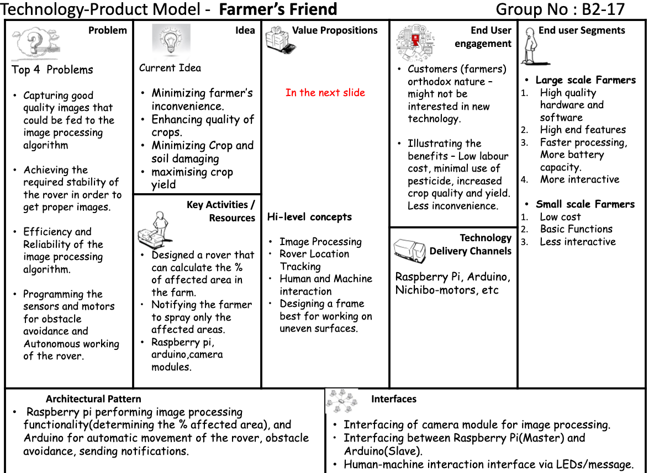
B
U
S
I
N
E
S
S
M
O
D
E
L
I
N
G

Slide 11
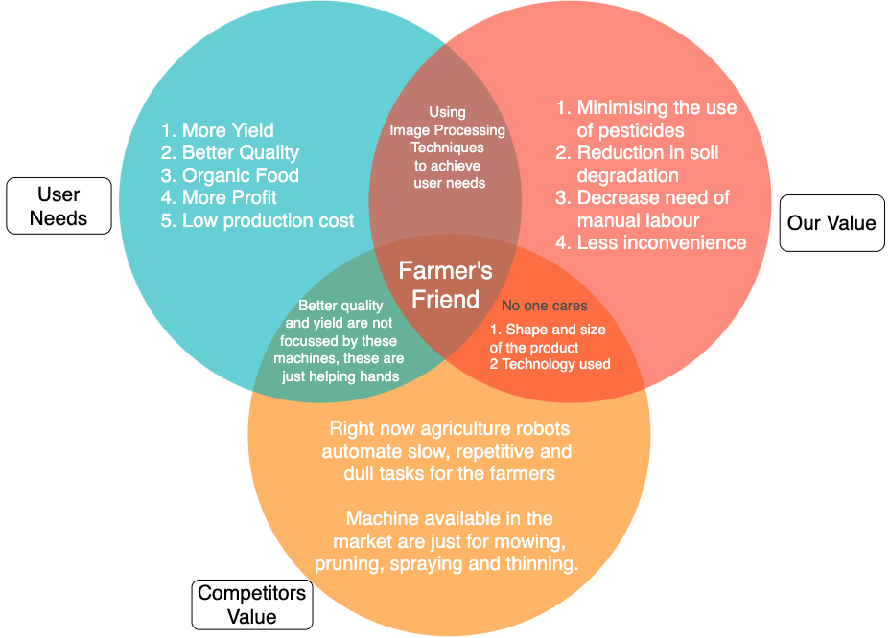
Value Proposition

Slide 12
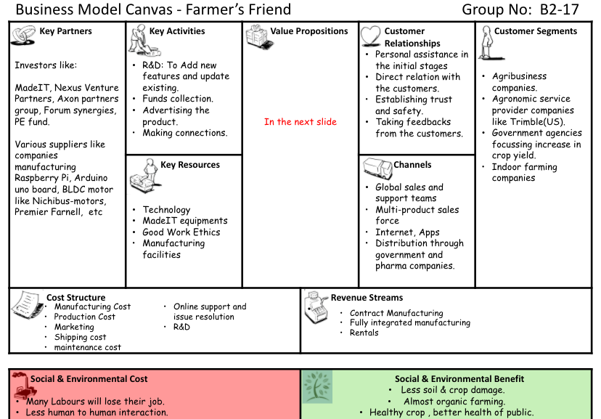

Slide 13
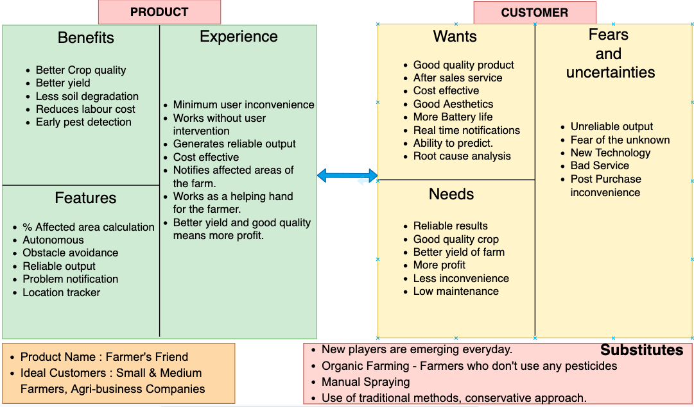
Value Proposition

Slide 14
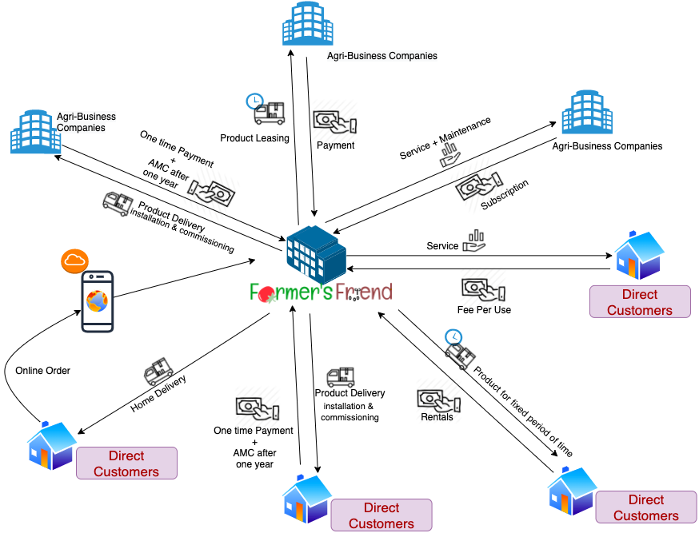
Farmer’s Friend
REVENUE MODEL
Plan

Slide 15
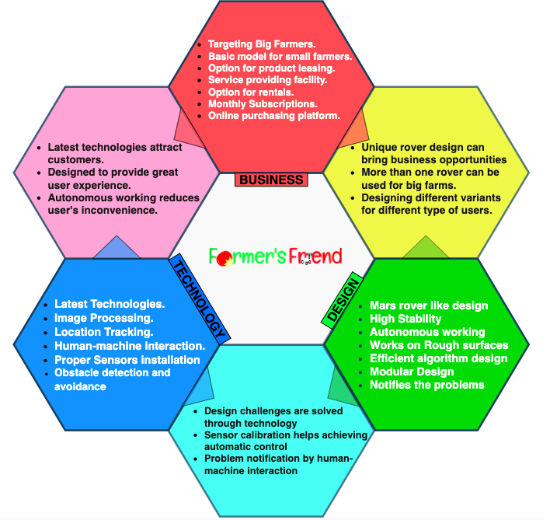
All being said, These are our
KEY DIFFERENTIATORS
That set us apart from the competition.

Slide 16
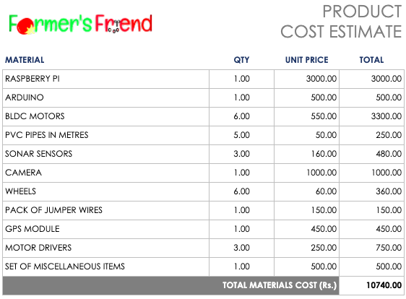
Farmer’s Friend
Product Cost Estimation
sheet
Continued...

Slide 17
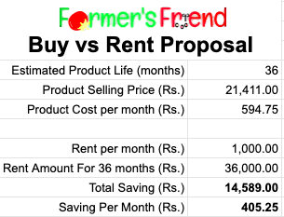
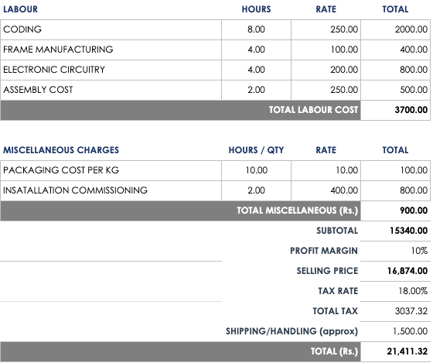

Slide 18
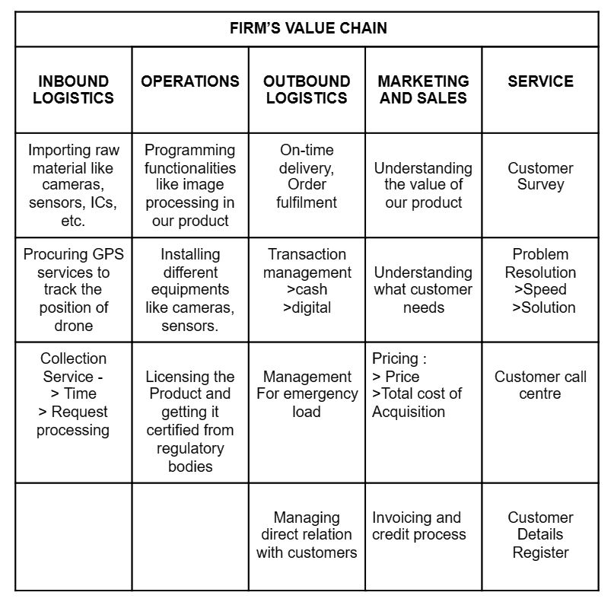
FIRM VALUE CHAIN ANALYSIS:
Value chain analysis is a strategy tool used to analyze internal firm activities. Value chain represents all the internal activities a firm engages in to produce goods and services. VC is formed of primary activities that add value to the final product directly and support activities that add value indirectly.Value chain analysis (VCA) is a process where a firm identifies its primary and support activities that add value to its final product and then analyze these activities to reduce costs or increase differentiation.Value chain represents the internal activities a firm engages in when transforming inputs into outputs.
rover

Slide 19
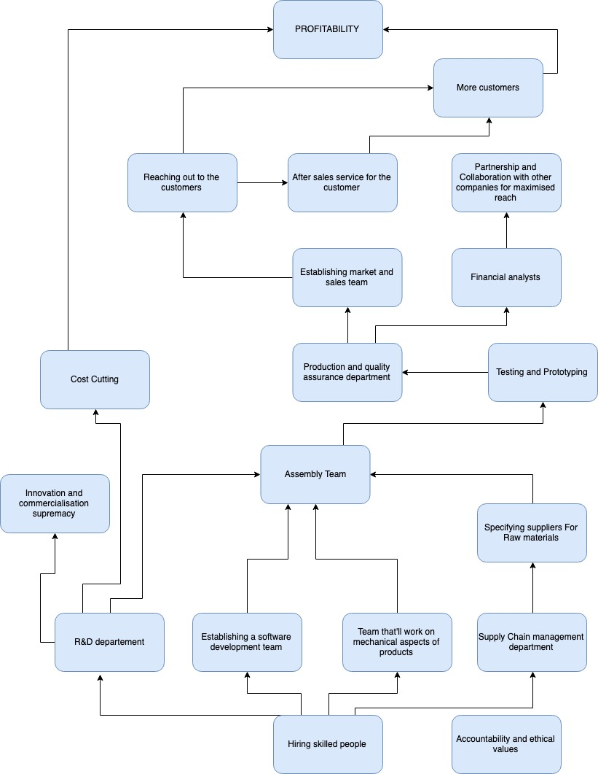
FUTURE BUSINESS STRATEGY:
To become a self sustained startup.
To come up with multiple product variants to target large spectrum of customers including large, medium and small scale farmers.

Slide 20
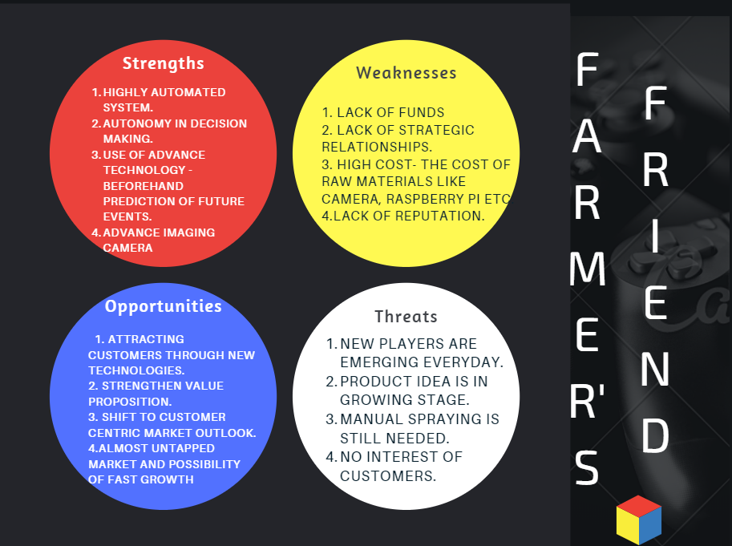
SWOT ANALYSIS:
SWOT analysis (or SWOT matrix) is a strategic planning technique used to help a person or organization identify strengths, weaknesses, opportunities, and threats related to business competition or project planning.
Strengths and weaknesses are internal to your company/startup—things that you have some control over and can change.
Opportunities and threats are external—things that are going on outside your company/startup, in the larger market. You can take advantage of opportunities and protect against threats, but you can’t change them.

Slide 21
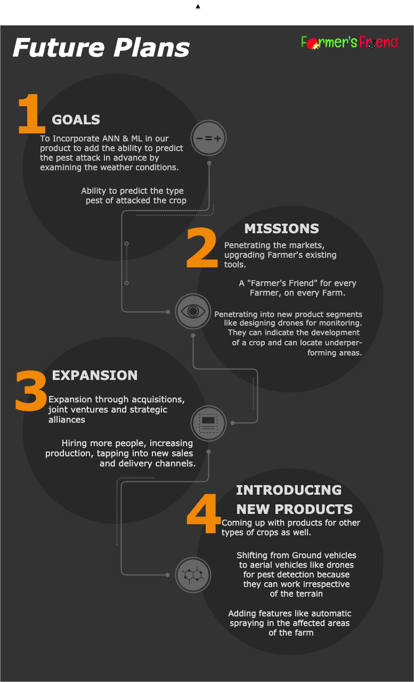
These are our
Future Plans
As a team
Continued….

Slide 22
Team Farmer’s Friend
Thank You
For your support

